Slide 1



SMART INDIA HACKATHON 2025
PROBLEM STATEMENT AND TEAM DETAILS
Problem Statement ID - SIH25044
Problem Statement Title- AI-Powered Crop Yield
Prediction and Optimization
Theme- Agriculture, Food Tech & Rural Development
PS Category- Software
Team ID-
Team Name- Team Outcast

Slide 2

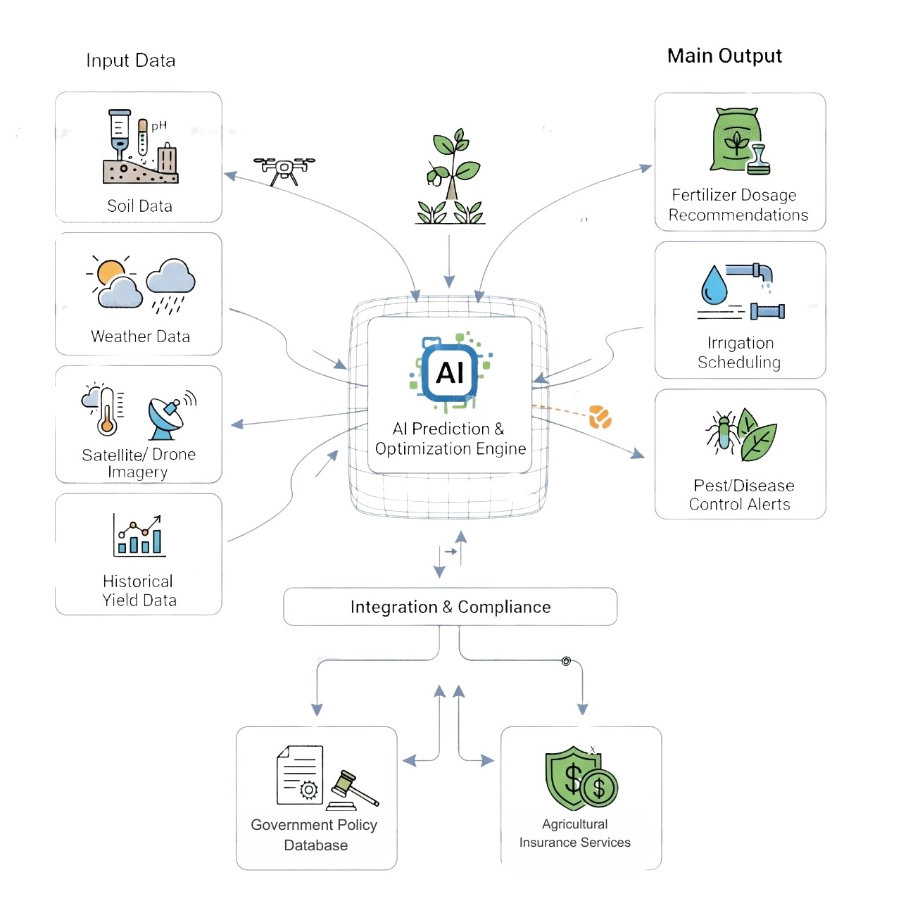
AI-POWERED CROP YIELD ADVISOR “तकनीक का ज्ञान, समृद्ध किसान।”
Proposed Solution
AI platform predicts crop yield using soil, weather, satellite & historical data.
Gives yield forecasts & help in decision making
Recommends fertilizer, irrigation, pest/disease control.
Innovation & Uniqueness
Farm-specific, data-driven, and tailored for Indian farmers.
Multi-source data fusion (APIs + satellite).
Provides actionable advice + links to govt schemes/insurance.

Slide 3

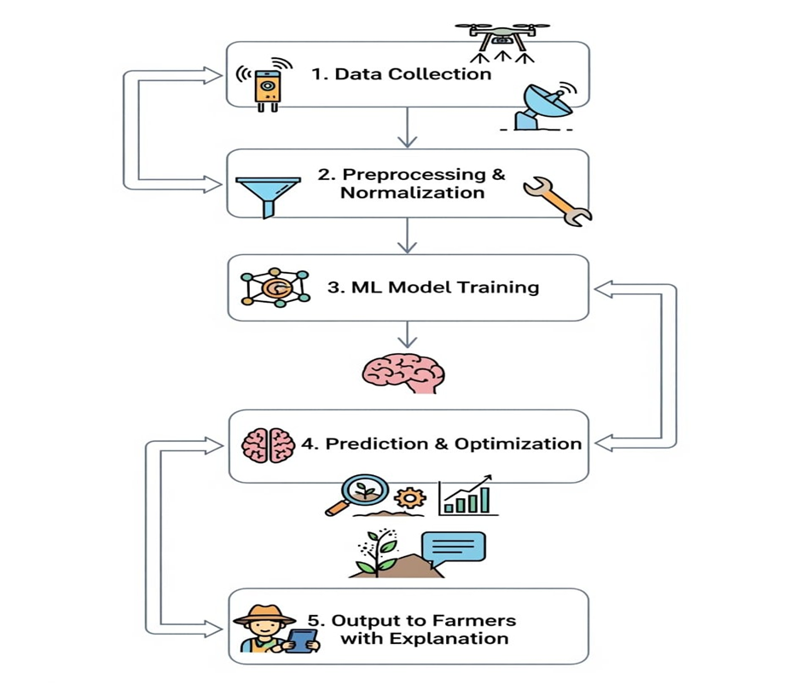








TECHNICAL APPROACH
Technologies to be used
Category | Technologies / Tools
Frontend | Flutter, React.js
Backend | Node.js, Express
AI / ML | Python (Scikit-Learn, TensorFlow, PyTorch )
Database | MongoDB
Data Sources | Weather APIs, IoT soil sensors, Satellite/Drone images, Historical records (future automation)
Deployment | AWS, Azure

Slide 4
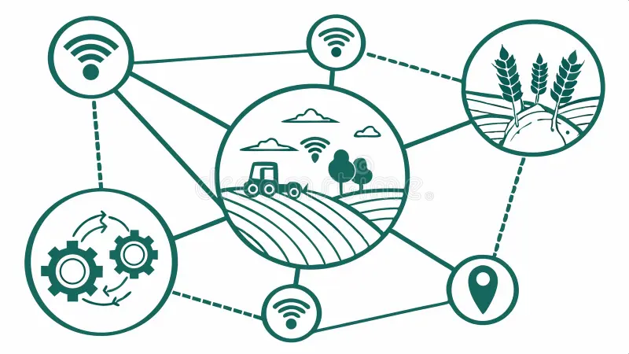
FEASIBILITY AND VIABILITY
Feasibility
Uses open-source APIs.
Scalable cloud-based architecture
Farmer friendly mobile app.
Challenges | Solutions
Lack of real-time data | Hybrid (farmer input + simulated APIs).
Poor internet | Offline mode with sync.
Low digital literacy | Simple UI, local languages.

Slide 5
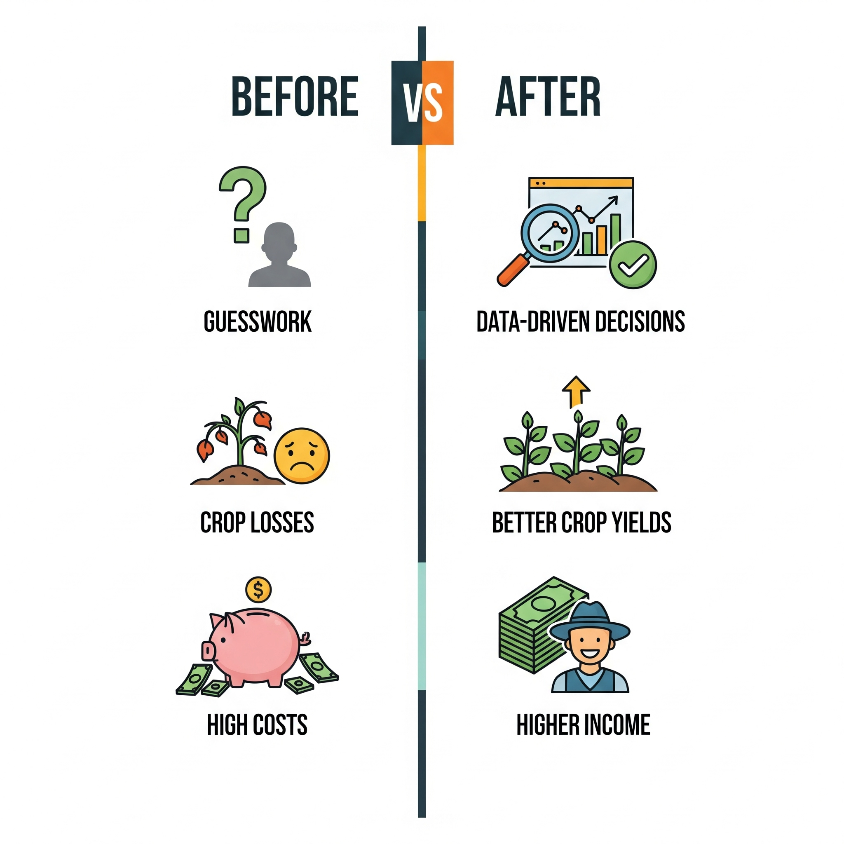
IMPACT AND BENEFITS
Impact
Empowers farmers, farm-specific insights.
Enables policy-making for government and subsidies.
Helps insurance companies in claim verification.
Promotes precision agriculture in India.
Benefits
Social: Improves farmer decision-making & livelihoods.
Economic: Reduces crop loss, improves productivity & income.
Environmental: Optimizes fertilizer/water use, reduces wastage.
Scalability
Expand to nationwide farmers
Integrate with govt schemes and insurances

Slide 6
RESEARCH AND REFERENCES
References
Existing Solutions
Kisan Suvidha App – Weather, mandi prices, advisories IndiaFilings, Budgam
IFFCO Kisan App – Weather, mandi, crop advisory GSMA, Times of Agri
Agribazaar App – Market rates, crop health, satellite insights
2. Data Sources / Documents
Weather APIs – OpenWeather, IMD → OpenWeather, IMD
Remote Sensing – Sentinel-2, Landsat → Landsat
Govt Sources – Agri records & reports → Agri Statistics
Research Papers – ML in Agriculture → Google Scholar, ResearchGate
Comparison with Existing Solution
Feature / Aspect | Kisan Suvidha | IFFCO Kisan | Agribazaar | Our Solution
Multi-source data fusion | ❌ | ❌ | ❌ | ✅
Farm-specific advice | ❌ | ❌ | ❌ | ✅
AI yield prediction | ❌ | ❌ | ❌ | ✅
Fertilizer & irrigation | ❌ | ✅ (basic) | ❌ | ✅ (advanced)
Govt/insurance integration | ✅ (info only) | ❌ | ❌ | ✅

